Slide 1
Databases - Introduction
Amos Azaria

Slide 2
Administration
Lecturers: Amos Azaria and Merav Chkroun
TAs: Chaya Levinger, and Keren Nivasch, Avigail Stekel
Classes (4 groups):
Tuesdays: 9:00-12:00 and 15:00-18:00 (Amos)
Sundays: 14:00-17:00 and 17:00-20:00 (Merav)
Office hour: Tuesdays at 14:00 (11.2.11)

Slide 3
Home Assignments
Grading policy:
4 Home assignments: Each assignment can add up to 2 bonus points to the final grade (you need at least 55 on the exam).
Final Grade: Test + bonus points
Submission in pairs.
First home assignment should be published on Monday (you will have 2 weeks to submit it).
Submission time is always at 23:55.
No late submission.
Only a subset of the questions in each assignment will be graded.

Slide 4
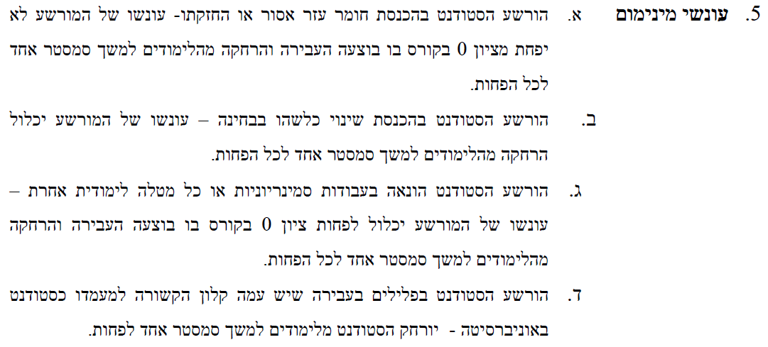
Don't copy! Don't share your work! Don't work in groups!

Slide 5
Github
You may not post your assignments to a public repository until after the deadline.
You may want to consider the usage of Bitbucket instead of Github, or use the private repository in Github.

Slide 6
Course Structure
Relational Databases Management Systems
SQL
Building databases
ERD Entity-Relational-Diagrams (next semseter)
Java
Connecting to MySQL
Streams
Object representation languages:
XML (and XSD)
JSON
NoSQL
Key-Value Store, Wide-Column Store, Document Store, Graph Store, Search Engines, RDF
Big Data
Spark
Naïve Bayes and Regression
Linear regression
Logistic regression
Handling huge amounts of data
What can we do when we need to know what might happen where we don't have data

Slide 7


לשון רבים-יחידה
Don’t worry, this is the only slide in Hebrew.
אם משהו לא ברור למישהו מכם, שישאל, כי כנראה יש עוד סטודנטים שלא מבינים (אבל אין להם את האומץ שלו לשאול).
אם משהו לא ברור למישהו או מישהי מכם או מכן, שישאל או שתשאל, כי כנראה יש עוד סטודנטים או סטודנטיות שלא מבינים או מבינות (אבל אין להם או להן את האומץ שלו או שלה לשאול).
אם משהו לא ברור למישהי מכם, שתשאל, כי כנראה יש עוד סטודנטים שלא מבינים (אבל אין להם את האומץ שלה לשאול).
מַפְלֶה!
מַלְאֶה!
משווה!

Slide 8
Relational Databases

Slide 9
Relational Databases
Relational databases are built from tables (relations), with attributes (columns) and entries (rows).
Each table represents a certain entity.
Rows in one table can be linked to rows in other tables (in the same database).
Relational data-bases are based upon relational algebra and SQL.
Most common databases in use:
Open Source: MySQL, SQLite, PostgreSQL
Proprietary: SQL Server and Oracle.

Slide 10
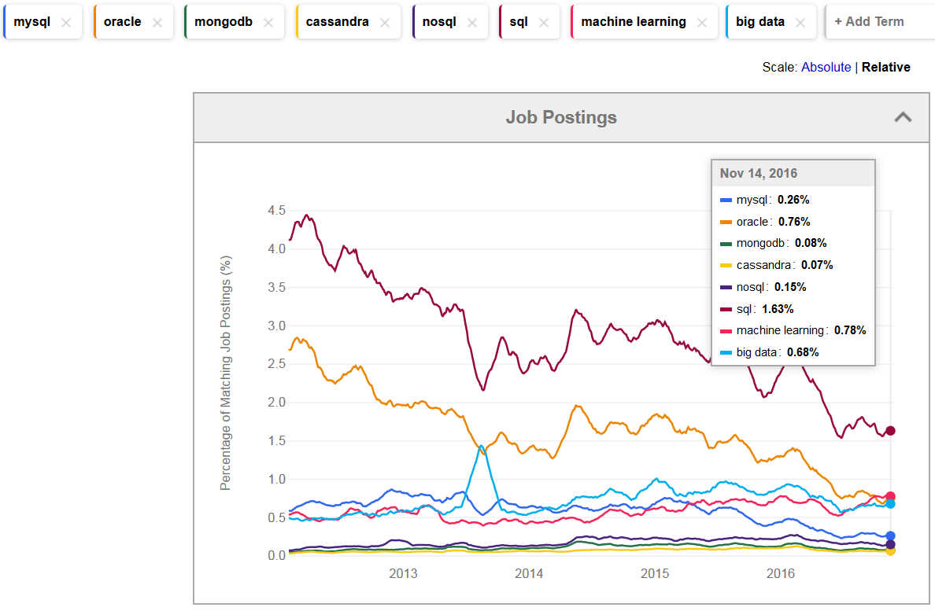
Trends from Indeed.com

Slide 11
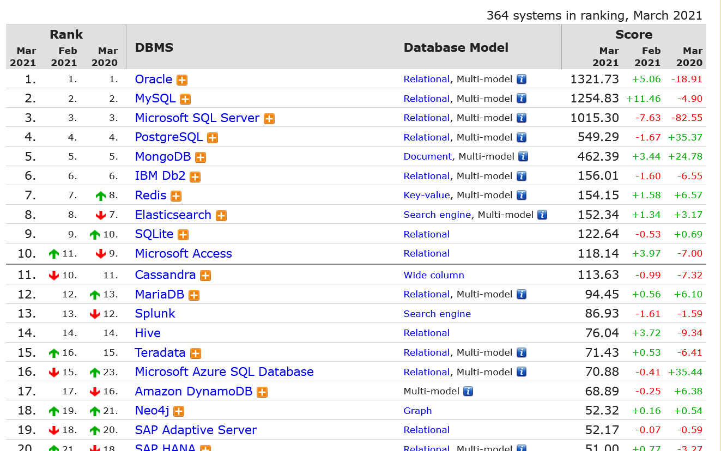
Database management system usage (http://db-engines.com/en/ranking)

Slide 12

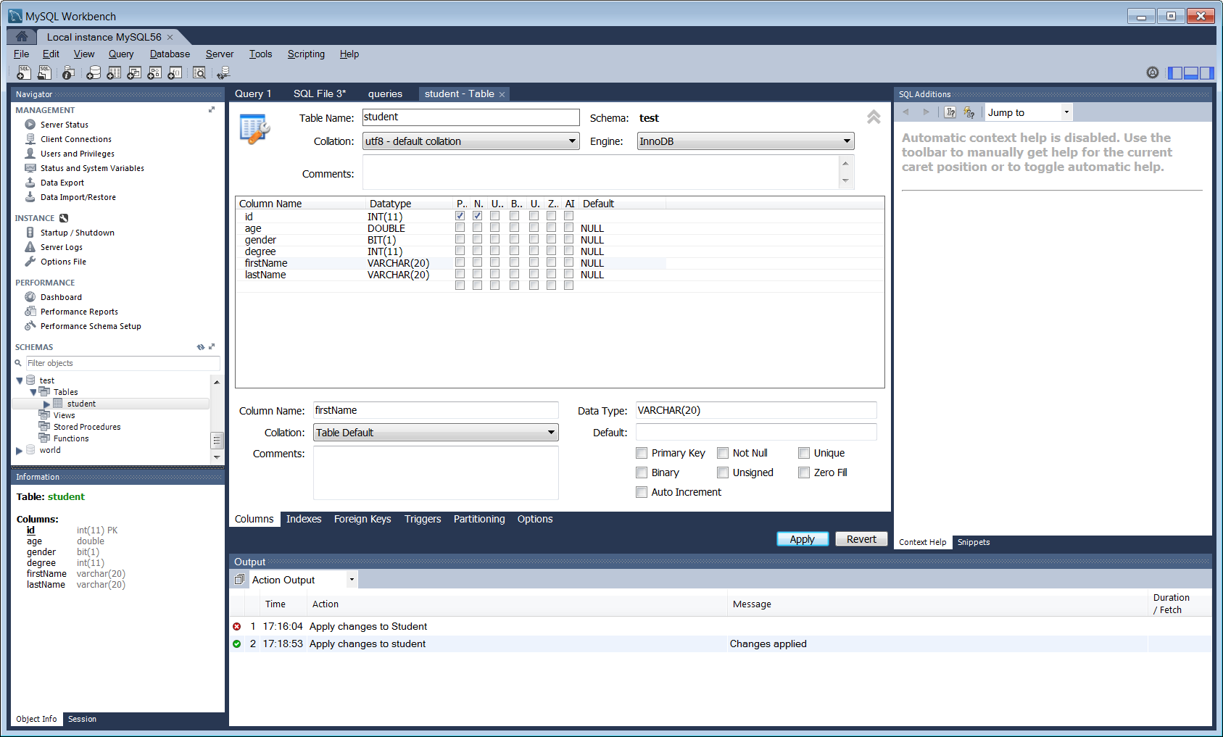
My SQL
Open source
Used a lot in the industry
Workbench GUI

Slide 13

Oracle
Proprietary, most widely used database in the industry.

Slide 14
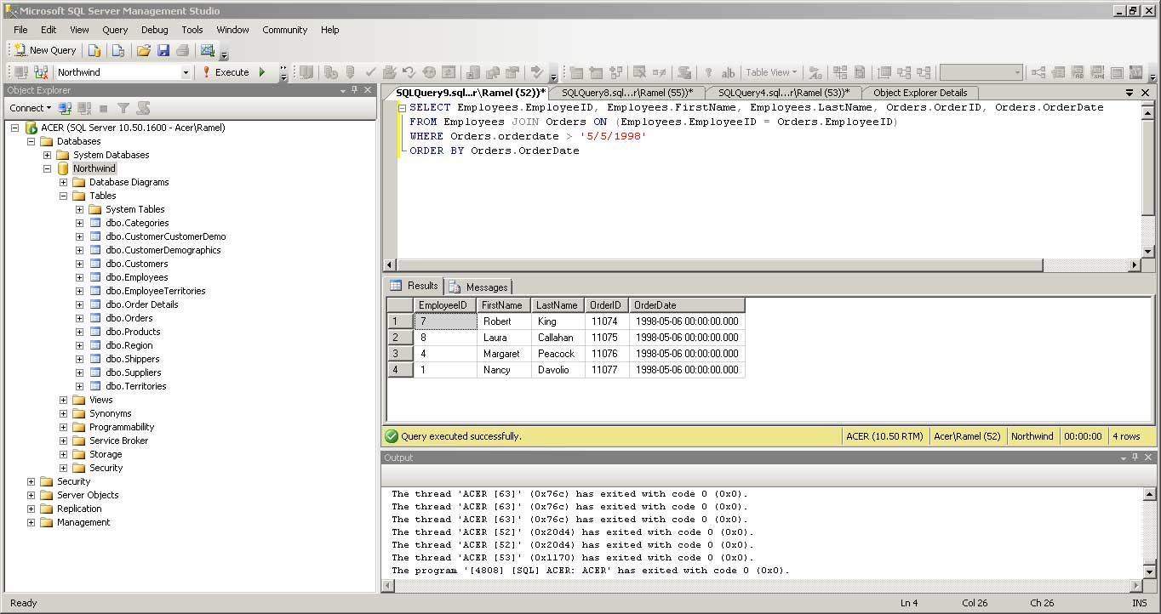

SQL Server
Proprietary (Microsoft) but used a lot in the industry as well.
SQL Management GUI
Will be used in the tutorials.

Slide 15
MySQL Installation
Go to https://dev.mysql.com/downloads/installer/, download the installer (scroll down and click the download button) and install:
MySQL Server
MySQL Workbench: A GUI that allows us to query the DB and presents the results.
MySQL Connectors:
JDBC Driver for MySQL (Connector/J): Allows us to connect to the DB from JAVA.
[ADO.NET Driver for MySQL (Connector/NET)]
You might also need to install Visual C++ Redistributable for Visual Studio 2015 from: https://www.microsoft.com/en-us/download/details.aspx?id=48145

Slide 16
ACID
Actions on a relational database are batched in transactions.
Atomicity: each transaction is either executed in full, or not executed at all.
Consistency: database remains consistent. Transaction does not violate any integrity constraints during its execution (if a transaction leaves the database in an illegal state, it is unrolled).
Isolation: the DBMS can execute many transactions in parallel, as long as the result is identical to a sequential execution.
Durability: a committed transaction always remains in database even in case of sudden power shortage or hardware/software failure etc.
Notes:
Consistency: inconsistent types (e.g. string in integer cell), a missing product id in orders list (referential integrity). (or going into overdraft)

